Slide 1
Responsive enterprise mobile development
Day 3

Slide 2
recap
Notes:
We assigned 10 minutes to this topic.

Slide 3
REcap
Mobile Device Management
Javascript 101 – Prototype
jQuery
EJS Templates
Backbone and Underscore Fundamentals
C# MV* => Javascript
RequireJS
Debugging in Chrome and Safari
C# => JS
Built a Game Selection View in Scavhn up to the Metal using Koans

Slide 4
On the dance card for today
CSS Animation / Animation with jQuery
CSS with SASS and Compass
LAB: Style the Scavhn Home Screen with SASS and Compass
iOS Ad Hoc Over The Air Deployments
Javascript Unit Testing with Jasmine, SinonJS, Karma, and PhantomJS
Angular
Knockout

Slide 5

jQuery part 2 – Animation and CSS –based animation
Notes:
We assigned 30 minutes to this topic.

Slide 6
jQuery part 2 – Animation and CSS – based animation
Entire section of jquery.com devoted to effects:
http://api.jquery.com/category/effects/
Fades
-webkit-transform & -webkit-transition
jQuery.transit – a jQuery add-on that facilitates CSS Animation
http://ricostacruz.com/jquery.transit/
Notes:
http://www.w3schools.com/css3/css3_transitions.asp
http://css-tricks.com/slide-in-as-you-scroll-down-boxes/
http://www.gograybox.com/blog/css-3d-transitions-an-introduction/

Slide 7

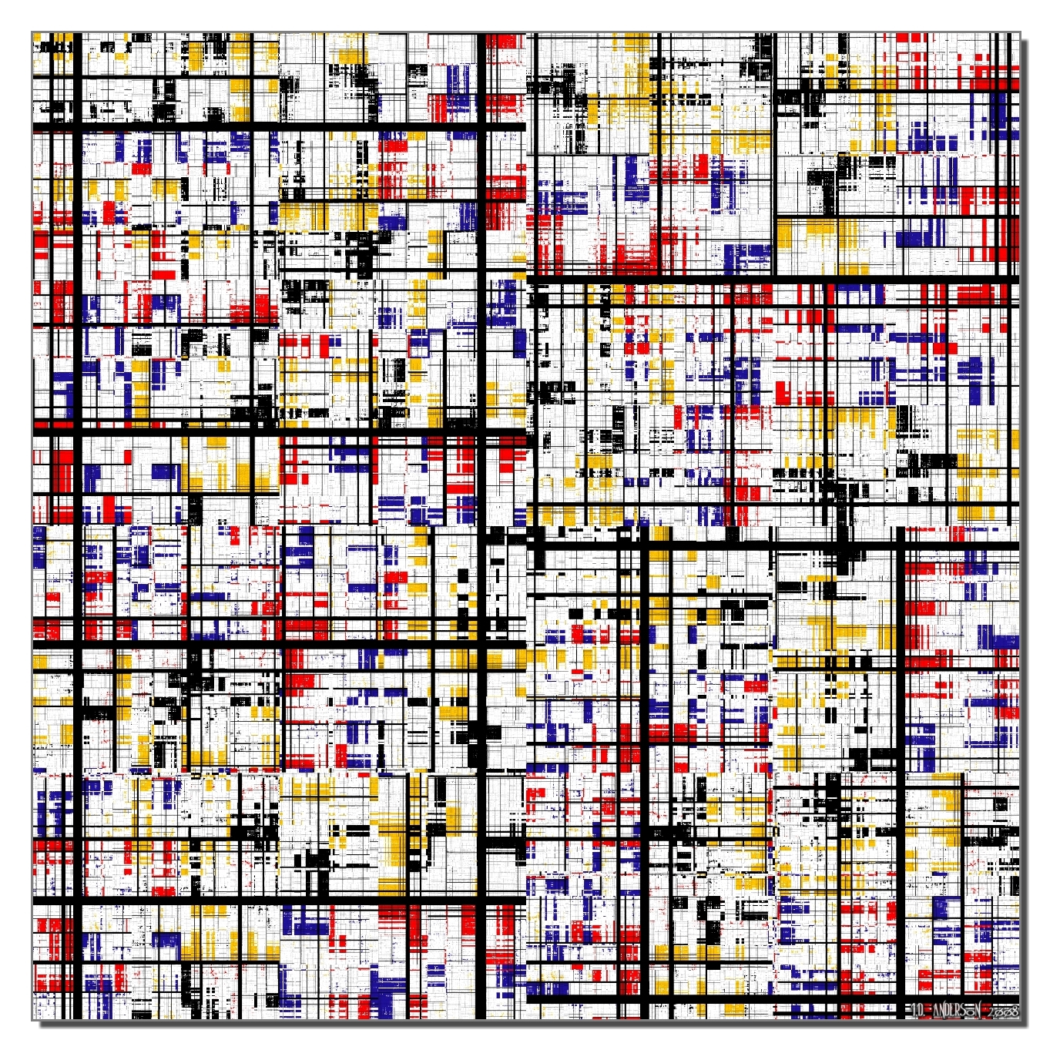
Lab: Styling
Notes:
We assigned 90 minutes to learn about CSS, Sass/Compass, and do this lab.

Slide 8
Lab: Styling
In this lab, you will style some of the hybrid app you created yesterday.
Notes:
Lab purpose slide

Slide 9
The styling lab will focus on:
HTML / CSS
HTML5
SASS / COMPASS
LIVE EDIT
JAVASCRIPT
JASMINE
REQUIREJS
SINONJS
BACKBONE / UNDERSCORE
JQUERY
KARMA
PHANTOMJS
iOS - OBJECTIVE-C
UIWEBVIEW
OBJ-C MOCKS
AFNETWORKING
XCTEST
CORE DATA
TYPHOON

Slide 10




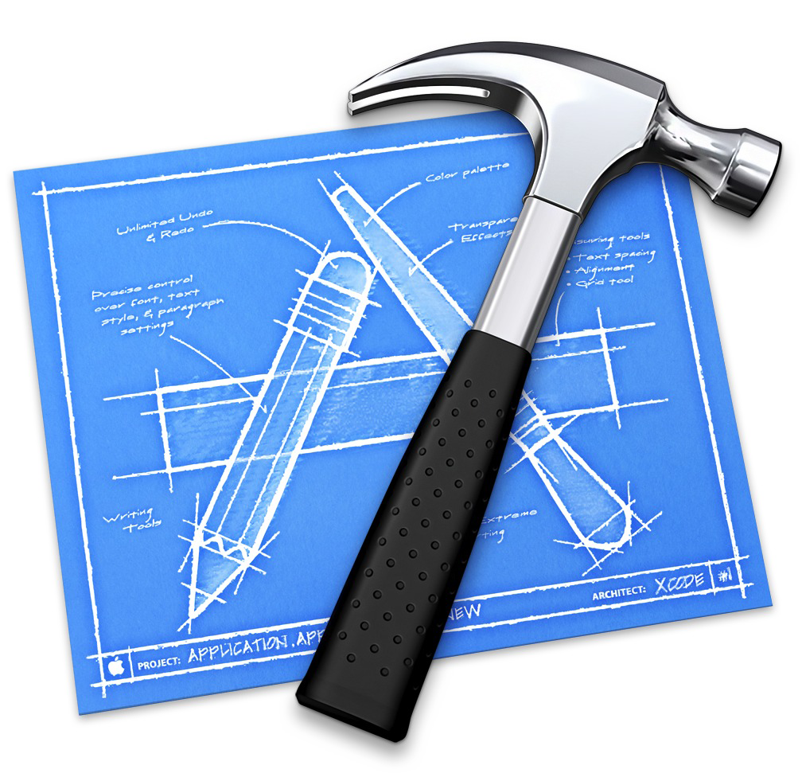

Tools we’ll be using
HTML / CSS
Safari
WebStorm
Photoshop
Chrome
JAVASCRIPT
Safari
JetBrains WebStorm
Chrome
iOS - OBJECTIVE-C
Xcode 5
JetBrains AppCode

Slide 11
Lab: Styling CSS and Sass/Compass
SASS is a CSS precompiler language
Provides many productivity and collaboration niceties
Facilitates OO-like reuse through variables, and mixins, imports, extends
Helper functions –
rgb($red, $green, $blue) - Creates a Color from red, green, and blue values.
quote($string) – Adds quotes to a string.
Control Directives: @if, @for, @each, @while
Compass is the “compiler”. Runs from the command line.
Notes:
Lab details slide

Slide 12
Lab: Styling SASS mixin example
Plain wrap CSS:
.scav-items-view {
width: 100%;
position: relative;
overflow: hidden;
background-color: #e9e9e9;
}
.scav-items-footer {
width: 100%;
position: relative;
overflow: hidden;
background-color: #ffffff;
}
Can be collapsed to
@mixin scav-items-base($color) {
width: 100%;
position: relative;
overflow: hidden;
background-color: $color;
}
.scav-items-view {
@include scav-items-base(#e9e9e9);
}
.scav-items-footer {
@include scav-items-base(#ffffff);
}
Notes:
Lab details slide

Slide 13
Lab: Styling SASS mixin example
Plain wrap CSS:
.scav-items-view {
width: 100%;
position: relative;
overflow: hidden;
background-color: #e9e9e9;
}
.scav-items-footer {
width: 100%;
position: relative;
overflow: hidden;
background-color: #ffffff;
}
Can be collapsed to
@mixin scav-items-base($color) {
width: 100%;
position: relative;
overflow: hidden;
background-color: $color;
}
.scav-items-view {
@include scav-items-base(#e9e9e9);
}
.scav-items-footer {
@include scav-items-base(#ffffff);
}
Notes:
Lab details slide

Slide 14
Lab: Styling Getting from wireframes to views with Sass/Compass
Let’s get to it.
Notes:
Lab details slide

Slide 15
Lab: Styling Getting from wireframes to views with Sass/Compass
Configure WebStorm for SASS/Compass
Webstorm > Preferences (Command + ,)
Enter “file watcher” in the search box:
Notes:
Lab details slide

Slide 16
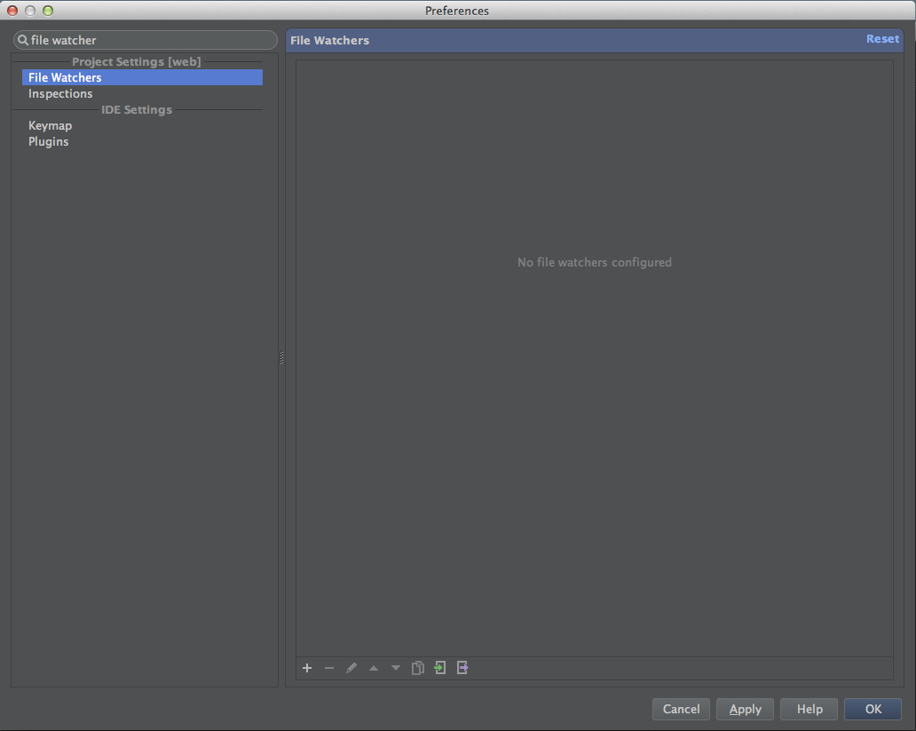
Lab: Styling Getting from wireframes to views with Sass/Compass
Notes:
Lab details slide

Slide 17
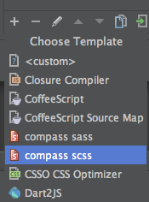
Lab: Styling Getting from wireframes to views with Sass/Compass
Configure WebStorm for SASS/Compass
Click on the plus sign at the bottom left of the right-hand pane, and select “compass scss” from the context menu:
Notes:
Lab details slide

Slide 18
Lab: Styling Getting from wireframes to views with Sass/Compass
Configure WebStorm for SASS/Compass
In the Edit Watcher Dialog, enter the following:
Arguments:
compile -c $ProjectFileDir$/../../compass/config.rb $ProjectFileDir$/scss/screen.scss
Working Directory:
$ProjectFileDir$
So your dialog should look like:
Notes:
Lab details slide

Slide 19
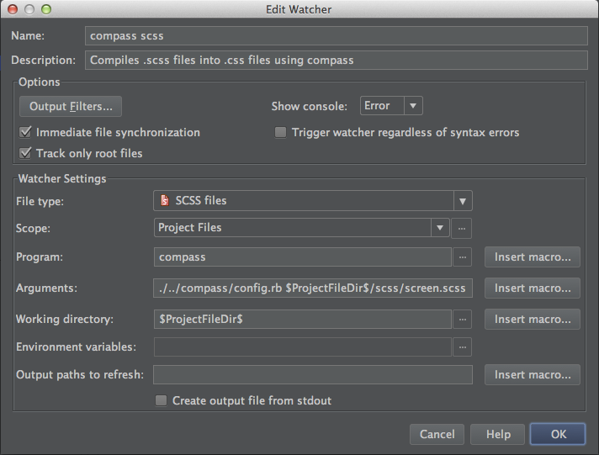
Lab: Styling Getting from wireframes to views with Sass/Compass
Notes:
Lab details slide

Slide 20
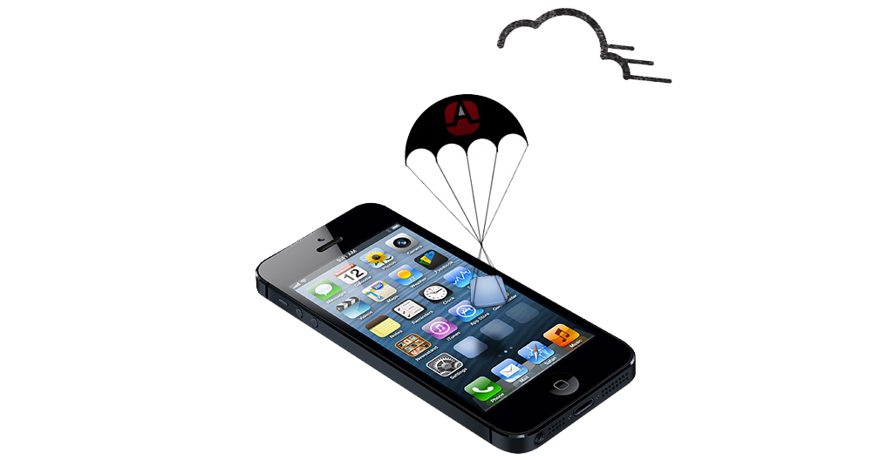
Ad hoc OTA (over the air) deployments
Notes:
We assigned 60 minutes to this topic.
Talk about Mobile Device Management here – MobileIron, TestFlight

Slide 21
Ad hoc OTA deployments
Build a .ipa Archive
Create HTML and a manifest to download from
Drop everything above out on a web server

Slide 22


Tools we’re using for this lab
Xcode 5
TextMate
OSX Server’s Web Server

Slide 23
Ad hoc OTA deployments
Let’s do it!

Slide 24

unit testing javascript
Notes:
We assigned 2 hours to learn about it and do this lab.

Slide 25
js unit testing
Jasmine
The problem: Require.js.
The solution: Big Doggie Dogg Re-Director
Mocking: Jasmine Spies and Sinon.js
Karma Test Runner
Notes:
Lab purpose slide

Slide 26
Lab: unit testing
Notes:
We assigned 2 hours to learn about it and do this lab.

Slide 27
the unit test lab will focus on:
HTML / CSS
HTML5
SASS / COMPASS
LIVE EDIT
JAVASCRIPT
JASMINE
REQUIREJS
SINONJS
BACKBONE / UNDERSCORE
JQUERY
KARMA
PHANTOMJS
iOS - OBJECTIVE-C
UIWEBVIEW
OBJ-C MOCKS
AFNETWORKING
XCTEST
CORE DATA
TYPHOON

Slide 28
Tools we’ll be using
HTML / CSS
Safari
JetBrains WebStorm
Chrome
JAVASCRIPT
Safari
JetBrains WebStorm
Chrome
iOS - OBJECTIVE-C
Xcode 5
JetBrains AppCode

Slide 29
Lab: unit testing Jasmine and Sinon.JS mocks
Write a unit test
Notes:
Lab details slide

Slide 30
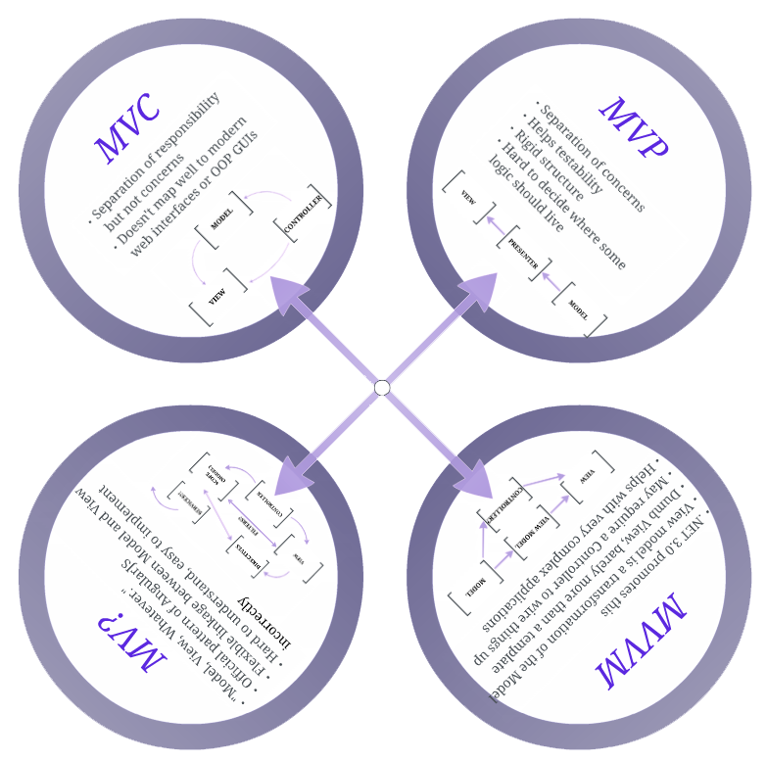

MVWhatever
Notes:
We assigned 60 minutes to this topic.

Slide 31



MVWhatever
?
?
Notes:
http://stackoverflow.com/questions/14505016/angularjs-or-backbone-js
http://www.martywong.com/blog/backbone-vs-ember-vs-angular-vs-knockout-review
http://stackoverflow.com/questions/5112899/knockout-js-vs-backbone-js
http://jsperf.com/angular-vs-backbone-vs-knockout-vs-avalon/5

Slide 32
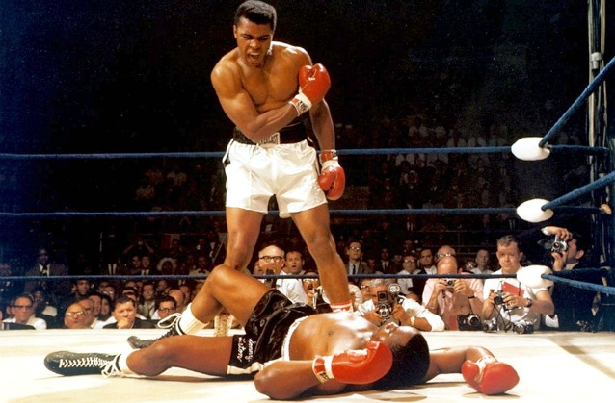

KnockoutJS
Notes:
We assigned 60 minutes to this topic.
http://en.wikipedia.org/wiki/Muhammad_Ali_vs._Sonny_Liston
Liston was the most intimidating fighter of his day, and considered by some, at the time of the Clay fight, as among the best heavyweights of all time. Many were reluctant to meet him in the ring. Henry Cooper, the British champion, said that if Cassius Clay won, he was interested in a title fight, but if Liston won, he was not going to get in the ring with him. Cooper's manager Jim Wicks said, "We don't even want to meet Liston walking down the same street."
Harold Conrad, the boxing promoter, said, "People talked about Tyson before he got beat, but Liston was more ferocious, more indestructible . . . . When Sonny gave you the evil eye -- I don't care who you were -- you shrunk to two feet tall."[2] Tex Maule, writing for Sports Illustrated, said, "Liston's arms are massively muscled, the left jab is more than a jab. It hits with true shock power. It never occurred to Liston that he might lose a fight.[3] Johnny Tocco, a trainer who worked with George Foreman and Mike Tyson as well as Liston, said Liston was the hardest hitter of the three.[4] Several boxing writers actually thought Liston could be damaging to the sport because he couldn't be beaten.[5] Liston's ominous, glowering demeanor was so central to his image that Esquire Magazine caused a controversy by posing him in a Santa Claus hat for its December 1963 cover.
Liston learned to box in Missouri State Penitentiary where he was serving time for armed robbery. Later, he was re-incarcerated for beating up a cop. For much of his career, his contract was majority owned by Frankie Carbo, a one time mob hit man and senior member of the Lucchese family, who ran boxing interests for the Mafia. Despite the fact that at the time the mob was deeply engaged in boxing at every level and that Liston's criminality had been in the past, he was never able to escape being labeled as the personification of everything that was unseemly and criminal in the sport. He distrusted boxing writers, and they paid him back, often depicting him as little more than a ignorant thug and a bully. He was typically described in thinly-veiled racist terms - a "gorilla," "hands like big bananas." James Baldwin - who understood Liston perhaps better than anyone in the press, and who, unlike the boxing writers sympathized with and liked him - said, "Liston was the big Negro in every white man's hallway." He was a man who, according to David Remnick, "had never gotten a break and was never going to give one."
Cassius Clay, on the other hand, was a glib, fast-talking 22-year-old challenger who enjoyed the spotlight. Known as "The Louisville Lip," he had won the light-heavyweight gold medal at the 1960 Rome Olympics. He had great hand and foot speed and lightning fast reflexes, not to mention a limitless supply of braggadocio [6] However, Clay had been knocked down by journeyman Sonny Banks early in his career, and, in his previous two fights, had eked out a controversial decision against Doug Jones and—more seriously— was knocked down by a left hook with three seconds left in round four against the cut-prone converted southpaw Henry Cooper. Clay was clearly "out on his feet" in his corner after the round, and his trainer Angelo Dundee had to stall for time to allow Clay to recover. Although Clay rallied to win the fight in the next round, it seemed clear to many that he would be no match against the daunting Liston, who seemed a more complete boxer in every way than Cooper.

Slide 33
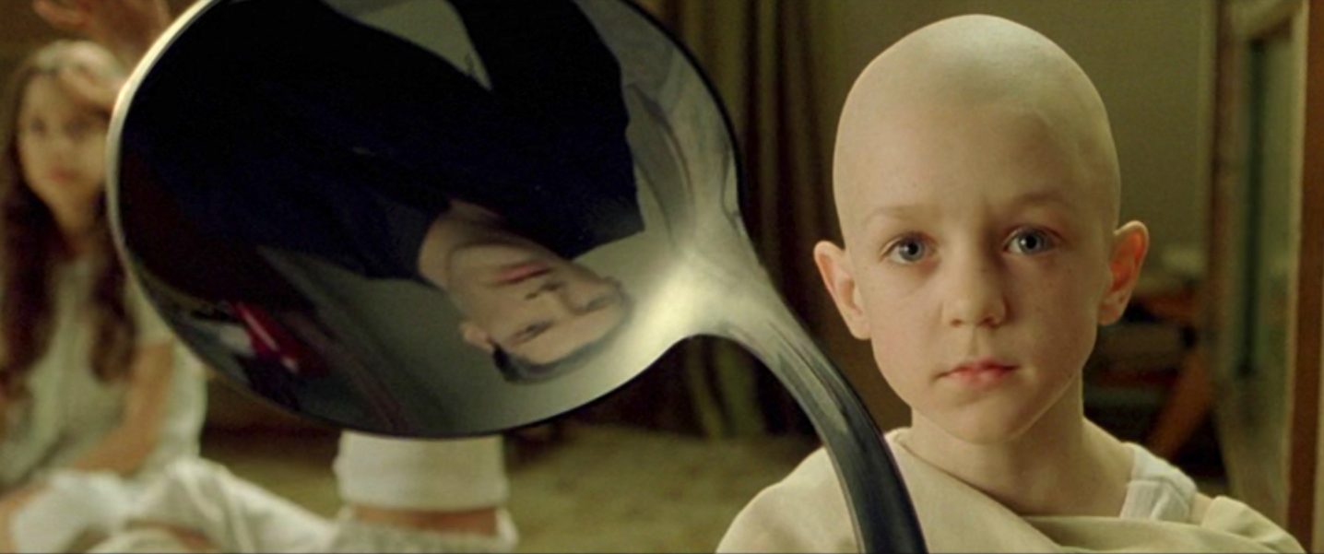
KnockoutJS
There is no Spoon. I mean model… Or views in the Backbone sense. There are viewmodels and bindings.
There is an Observable Arrays construct, similar to Observable Collections in .NET
No routing support out of the box. You will need another framework for that.
Notes:
Throw up the page and walk through some stuff for the first couple bullets. Encourage walkthrough of the tutorials tonight.
For the third bullet, callout Sammy.js or Pager.js as possible solutions to the routing problem.

Slide 34
KnockoutJS
LABWORK:
Work through all tutorials on the Knockoutjs – “Introduction” thru “Loading and Saving Data”
For those of you that have worked through these tutorials already, see me.
Notes:
Throw up the page and walk through some stuff for the first couple bullets. Encourage walkthrough of the tutorials tonight.
For the third bullet, callout Sammy.js or Pager.js as possible solutions to the routing problem.

Slide 35

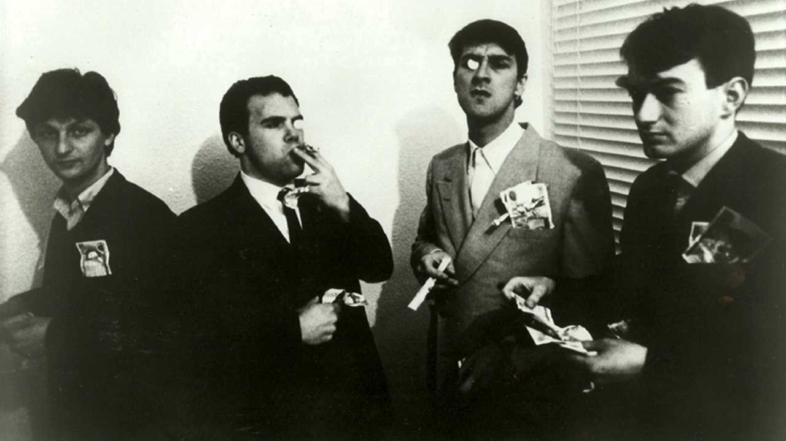
AngularJS
Notes:
We assigned 60 minutes to this topic.

Slide 36
AngularJS
Began as an open source project, later sucked up by Google.
Triggers changes from bindings, similar to Knockout
Has Controllers, Modules and Scope objects. The last two are where the “Whatever” comes in.
Notes:
Talk about Controllers.
Talk about modules
What is a Module?
Most applications have a main method which instantiates, wires, and bootstraps the application. Angular apps don't have a main method. Instead modules declaratively specify how an application should be bootstrapped. There are several advantages to this approach:
http://docs.angularjs.org/guide/module
NO Models. In Angular land, they are considered redundant. This is where the “Angular way” of doing things comes in.
Do not use controllers for:
Any kind of DOM manipulation — Controllers should contain only business logic. DOM manipulation—the presentation logic of an application—is well known for being hard to test. Putting any presentation logic into controllers significantly affects testability of the business logic. Angular offers databinding for automatic DOM manipulation. If you have to perform your own manual DOM manipulation, encapsulate the presentation logic in directives.
Input formatting — Use angular form controls instead.
Output filtering — Use angular filters instead.
Sharing stateless or stateful code across controllers — Use angular services instead.
Managing the life-cycle of other components (for example, to create service instances).

Slide 37
AngularJS
The Angular way of doing things
Dependency Injection! Built for testability from the ground up!
The more complicated the app, the steeper the anxiety curve.
Notes:
They write tomes on how to build their notion of a controller:
http://docs.angularjs.org/guide/dev_guide.mvc.understanding_controller
A view:
http://docs.angularjs.org/guide/dev_guide.mvc.understanding_view
And so on. Backbone is much more malleable this way. Doesn’t try to strong arm you into one specific pattern.
All of the tutorials come with test examples, and it comes with Karma, which they wrote. Very good solution based on the tutorials and boilerplate it comes with out of the box alone.
http://docs.angularjs.org/guide/module (Show them “Unit Testing”, about 1/3 of the way down.

Slide 38
AngularJS
LABWORK:
Angular Tutorials:
“0- Bootstrapping” through “4- Two-way Data Binding”: http://docs.angularjs.org/tutorial/step_00
“11-REST and Custom Services”: http://docs.angularjs.org/tutorial/step_11
Notes:
They write tomes on how to build their notion of a controller:
http://docs.angularjs.org/guide/dev_guide.mvc.understanding_controller
A view:
http://docs.angularjs.org/guide/dev_guide.mvc.understanding_view
And so on. Backbone is much more malleable this way. Doesn’t try to strong arm you into one specific pattern.
All of the tutorials come with test examples, and it comes with Karma, which they wrote. Very good solution based on the tutorials and boilerplate it comes with out of the box alone.
http://docs.angularjs.org/guide/module (Show them “Unit Testing”, about 1/3 of the way down.

Slide 39
That’s enough for today.
We start again tomorrow at 8:30.

